Slide 1
What’s new at the wetting front?
Christoph Mitterer
Bavarian Avalanche Warning Service
Réunion Atelier Neige – Grenoble
30 April 2015

Slide 2
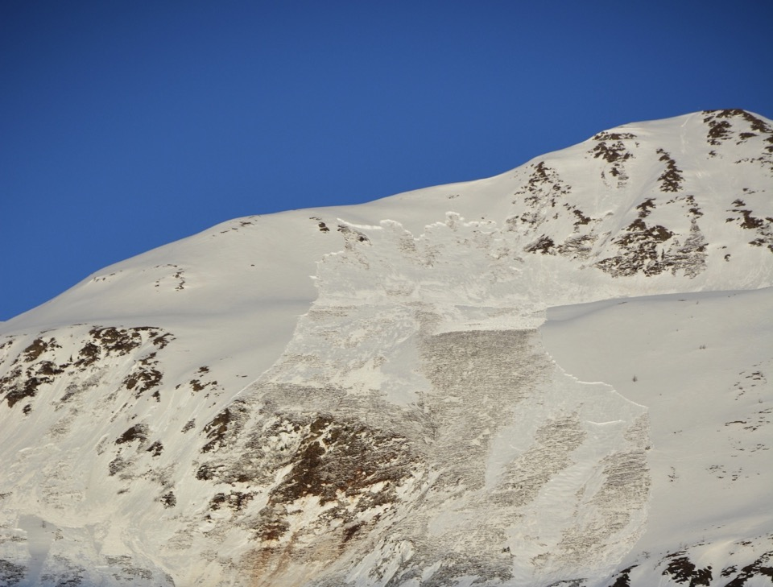
Foto: J. Schweizer

Slide 3
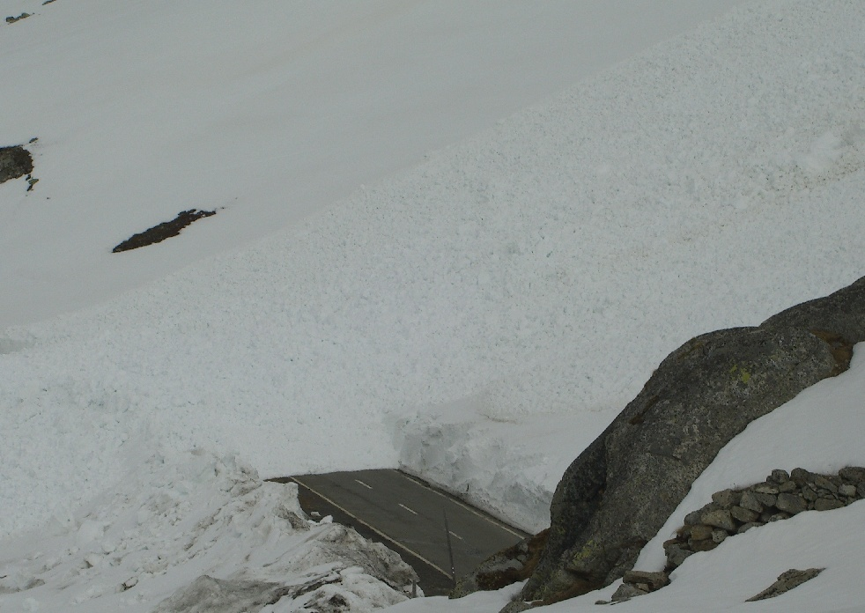
Wet-snow avalanche Flüelapass ~16 h Planned opening of the road 17 h
Foto: J. Rocco

Slide 4
Reasons for bad predictability
Formation processes are not fully understood.
Timing is extremely short.
Small differences in forcing (e.g. infiltration rate, snow stratigraphy) seem to be important.
High potential for feed-back mechanisms exist.
Schneebeli (2004)

Slide 5
Problems stated by avalanche professionals
No established procedure to assess wet-snow instability
No best-practice stability test
No evident meteorological parameter (air temperature?)
Indicator avalanches (only reliable parameter?)
Major forecasting problem concerns the correct onset of avalanche activity.
Techel and Pielmeier (2009)

Slide 6
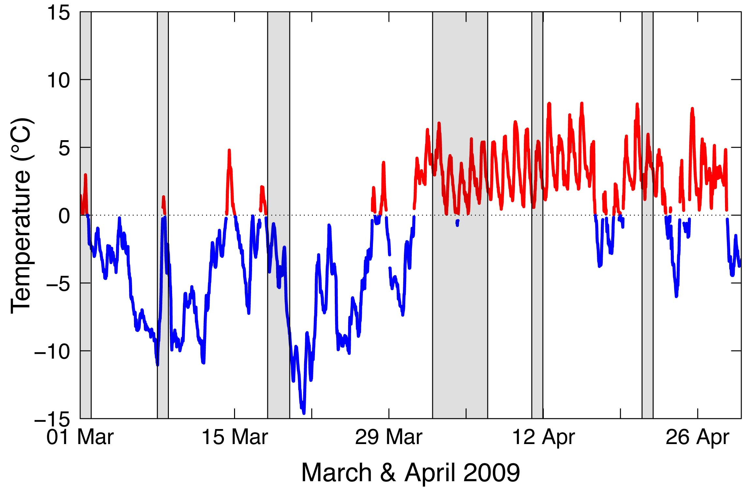
Air temperature as a proxy?
It works ☺ !

Slide 7
Air temperature as a proxy?
Oh no, maybe not ☹

Slide 8
Air temperature as a proxy?
Now it works again ☺ !

Slide 9
Air temperature as a proxy?
... not really ☹ !

Slide 10
What is the deal?
Do physically more complex model settings provide better predictions of wet-snow avalanche occurrence than simpler ones?

Slide 11
Models describing wet-snow avalanches
Baggi and Schweizer (2009)
3d-sum of positive TA, days since isothermal state, capillary barrier index (BAG)
Peitzsch et al. (2012)
Mean TA, maximum TA, decrease in HS (PEI)
Mitterer and Schweizer (2013)
5d-sum of positive TA (MIT1)
3d-sum of positive TA, mean TSS (MIT2)
Mitterer et al. (2013)
Modelled / measured energy and mass balance (MIT3)

Slide 12
Models describing wet-snow avalanches
Baggi and Schweizer (2009)
3d-sum of positive TA, days since isothermal state, capillary barrier index (BAG)
Peitzsch et al. (2012)
Mean TA, maximum TA, decrease in HS (PEI)
Mitterer and Schweizer (2013)
5d-sum of positive TA (MIT1)
3d-sum of positive TA, mean TSS (MIT2)
Mitterer et al. (2013)
Modelled / measured energy and mass balance (MIT3)

Slide 13
Models describing wet-snow avalanches
Baggi and Schweizer (2009)
3d-sum of positive TA, days since isothermal state, capillary barrier index (BAG)
Peitzsch et al. (2012)
Mean TA, maximum TA, decrease in HS (PEI)
Mitterer and Schweizer (2013)
5d-sum of positive TA (MIT1)
3d-sum of positive TA, mean TSS (MIT2)
Mitterer et al. (2013)
Modelled / measured energy and mass balance (MIT3)

Slide 14
Models describing wet-snow avalanches
Baggi and Schweizer (2009)
3d-sum of positive TA, days since isothermal state, capillary barrier index (BAG)
Peitzsch et al. (2012)
Mean TA, maximum TA, decrease in HS (PEI)
Mitterer and Schweizer (2013)
5d-sum of positive TA (MIT1)
3d-sum of positive TA, mean TSS (MIT2)
Mitterer et al. (2013)
Modelled / measured energy and mass balance (MIT3)

Slide 15
Energy balanced based index (LWC_{index})
At low liquid water content (θ_{w}), capillary forces dominate the water flow in snow (pendular regime).
If θ_{w} increases, water will start to flow downwards due to gravity (funicular regime).
The transition from the pendular to the funicular regime was experimentally observed at a volumetric liquid water content (θ_{w,v}) of 3‑8%.
LWC_{index} = θ_{w,v} / 0.03

Slide 16
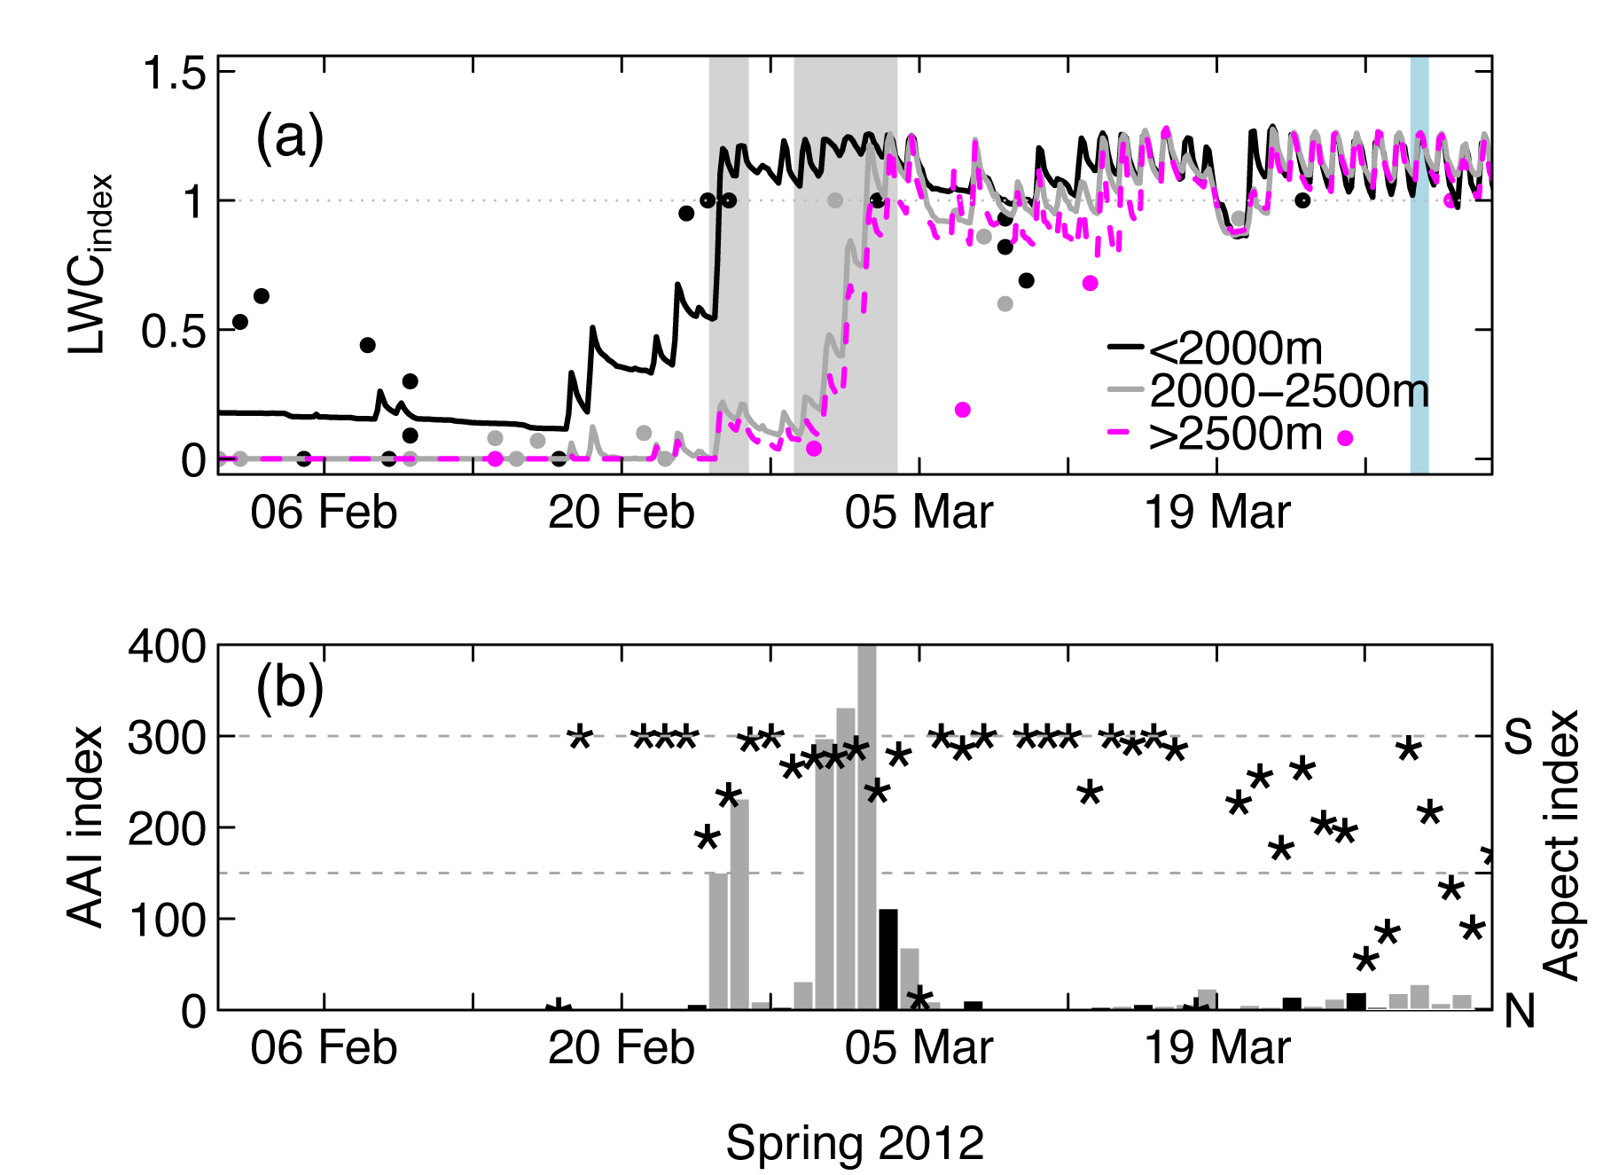
Energy balanced based index (LWC_{index})

Slide 17
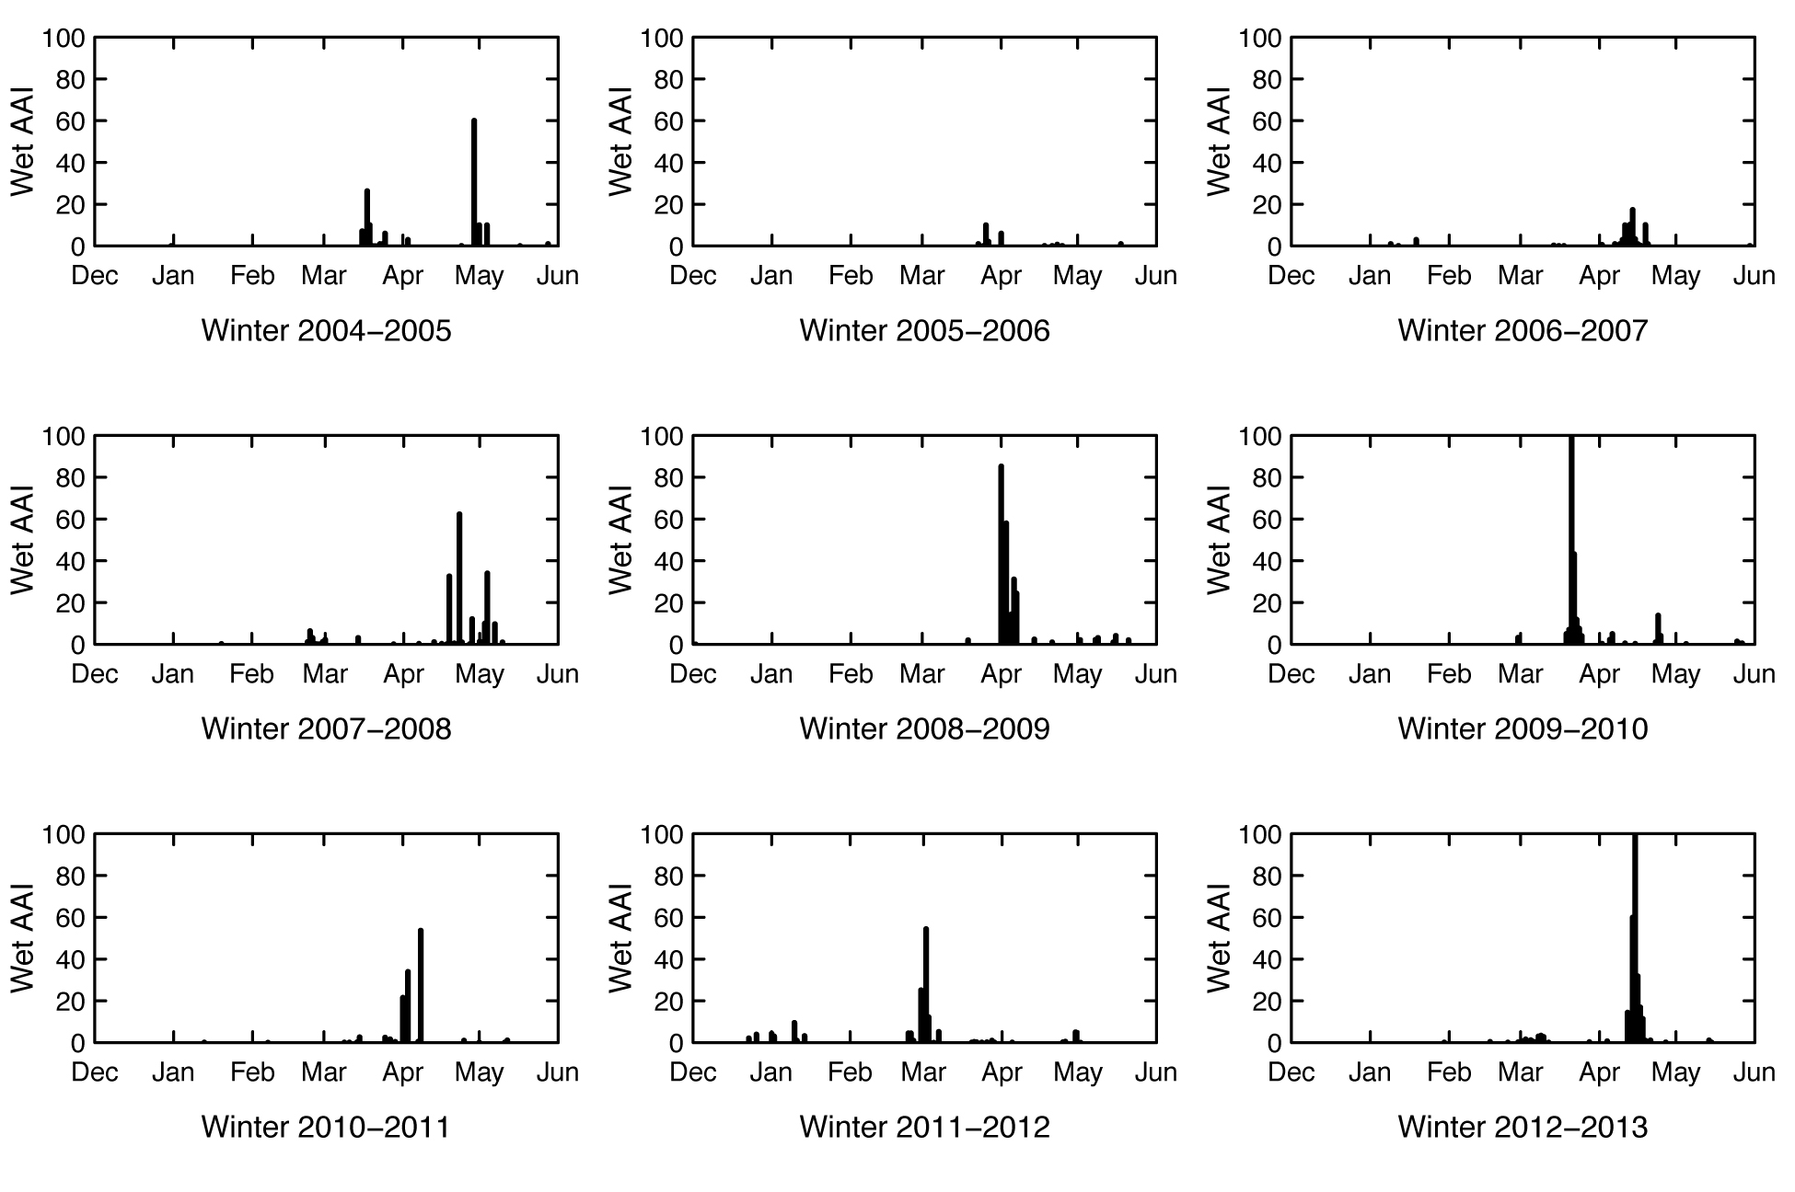
Verification with avalanche activity data

Slide 18
Predictive performance of models

Slide 19
What’s the story with the performance?
MIT2 and MIT3
Hit 8-9 out of 10 avalanche days
Low rate of misses, but still there
Recognise only 2/3 of the non-avalanche day
With both models you predict 7-9 times an avalanche day although no one occurs (high false alarm rate).
Makes the models not really suitable for operational use.

Slide 20
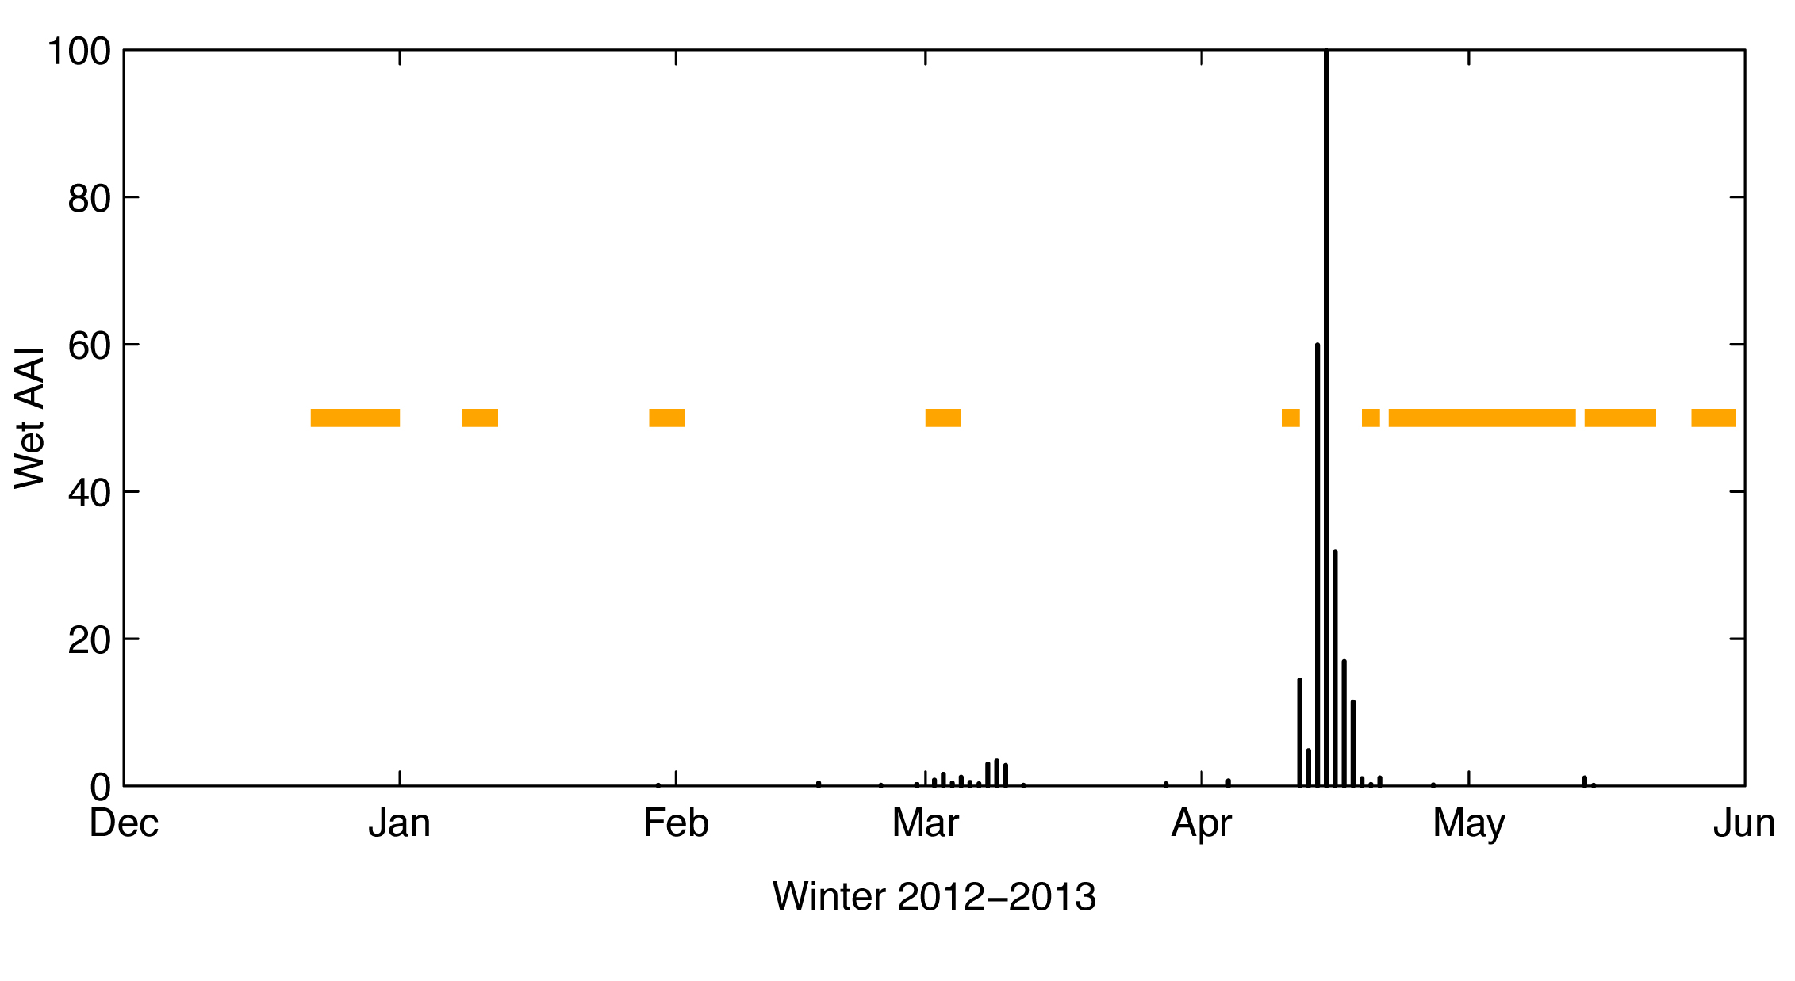
Where do the false alarms occur for MIT2?

Slide 21
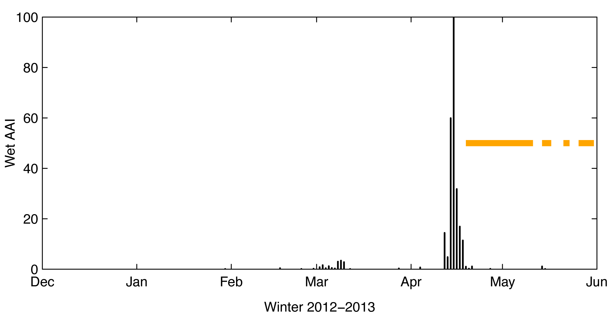
Where do the false alarms occur for MIT3?

Slide 22
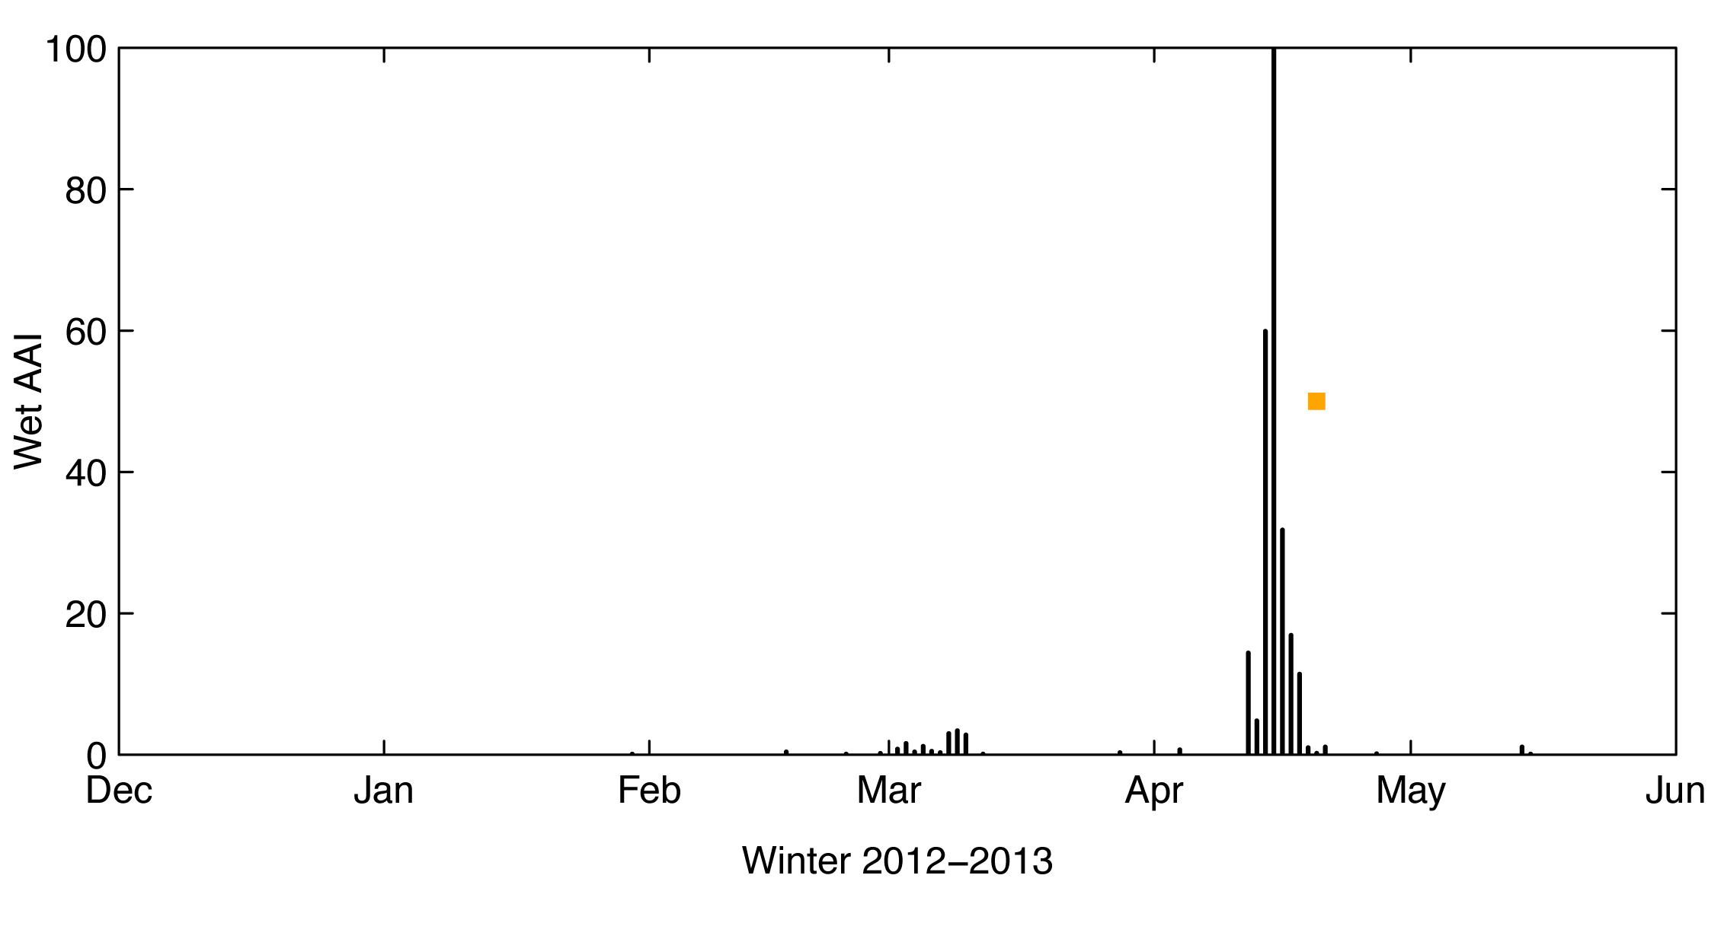
Introducing days since isothermal state (MIT3)

Slide 23
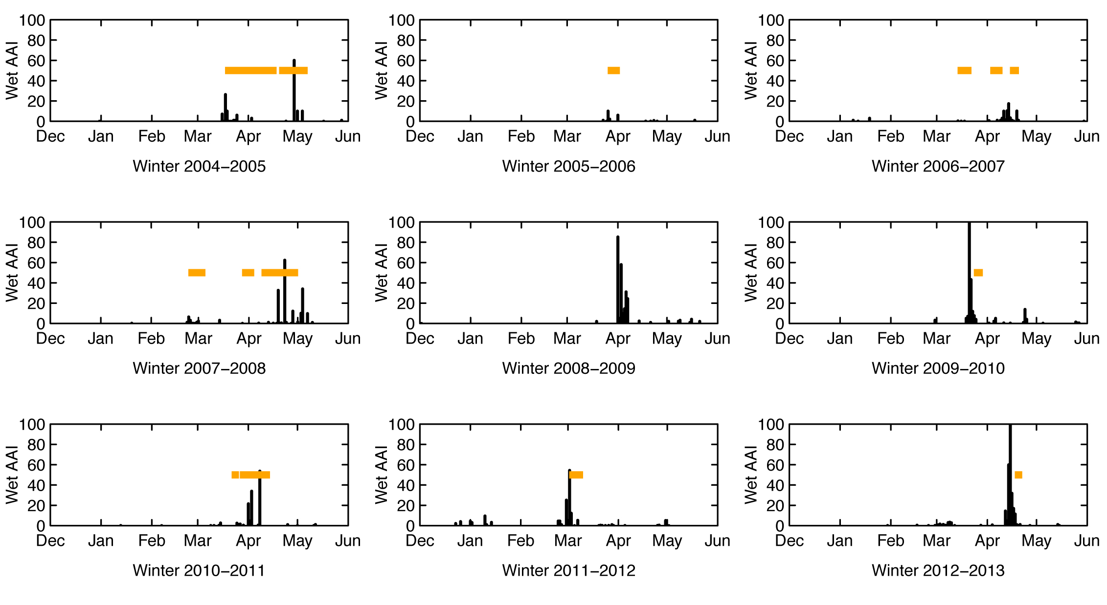
Introducing days since isothermal state (MIT3)
False-alarm rate reduced from ~0.8 to 0.45

Slide 24
Conclusions
Knowing energy input (e.g. 3d-sum of TA) and energetic state of the snowpack (e.g. TSS) provides best footing for forecasting models.
Not all higher complexity models do necessarily provide better predictions.
More complex models offer better options to tackle false alarms.
False alarms are governing the performance of the forecasts.
Forecasters are happy with the energy balance based index.

Slide 25
Outlook

Slide 26
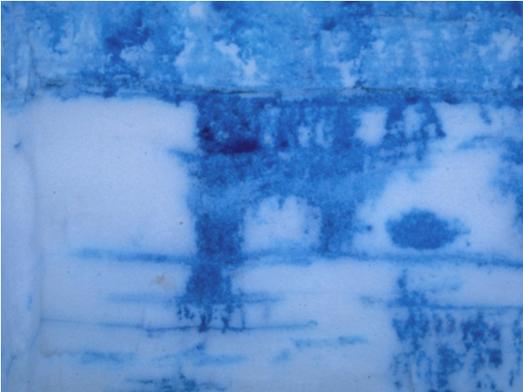
Measuring water in snow
…not straight forward

Slide 27
Why is measuring water so important?
Strength
0
3
7
Liquid water content (% vol.)

Slide 28
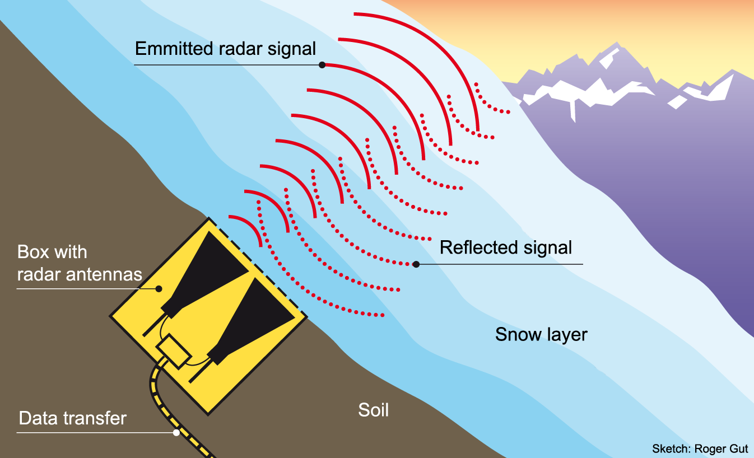
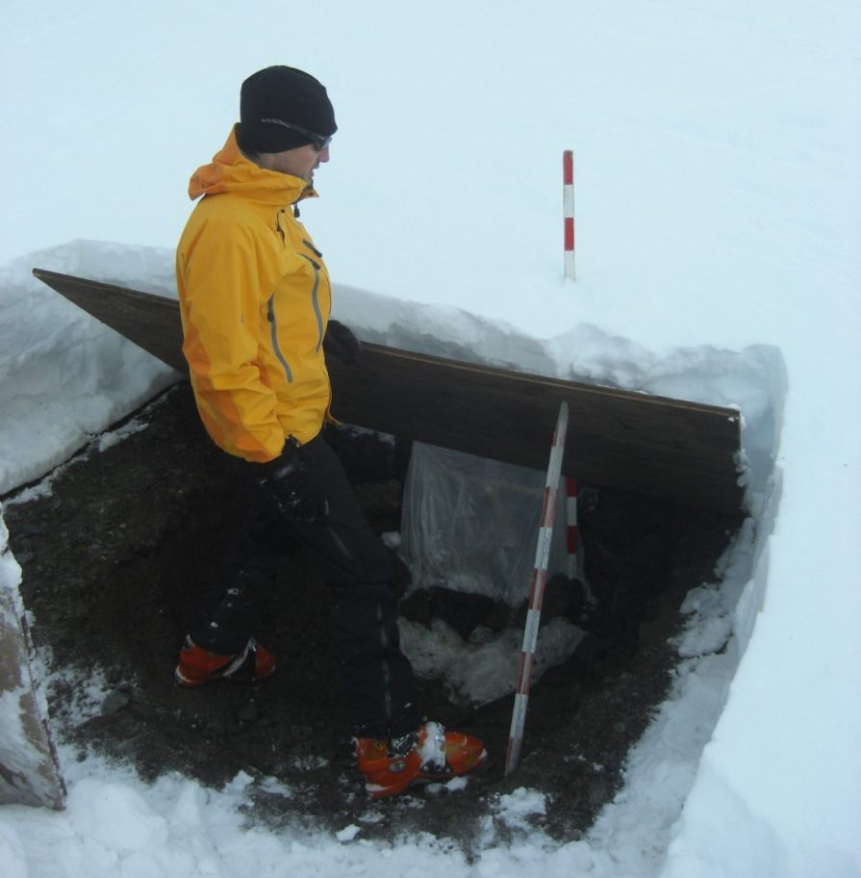
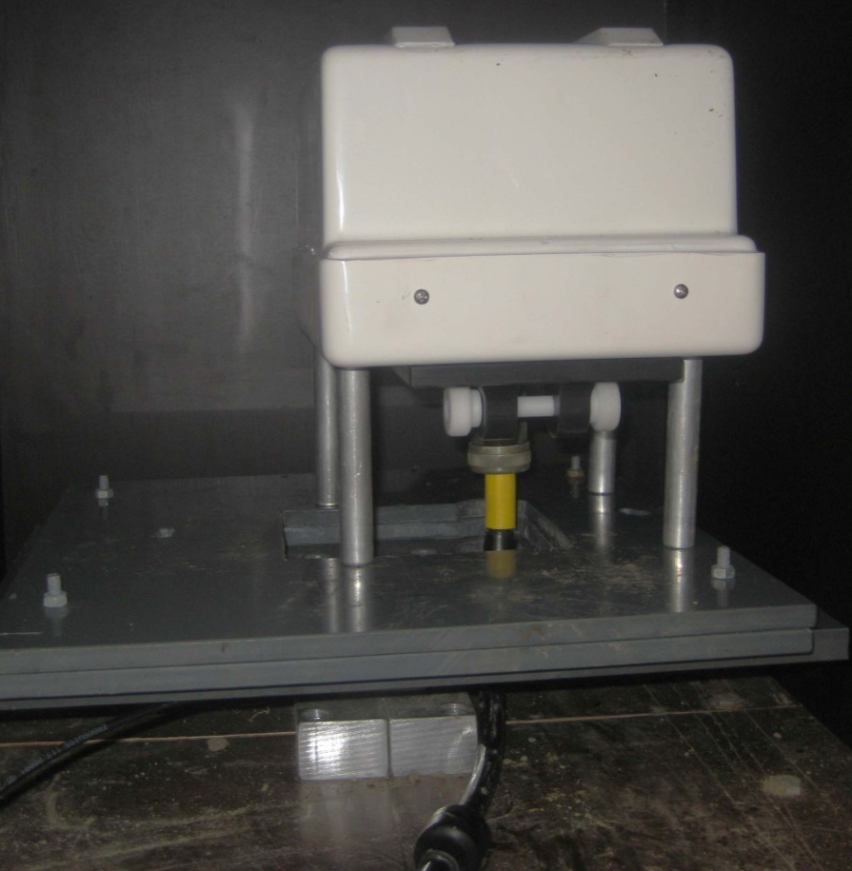
upGPR: Setup in the field

Slide 29
Monitoring snowpack with a radar signal
Schmid et al. (2014)

Slide 30
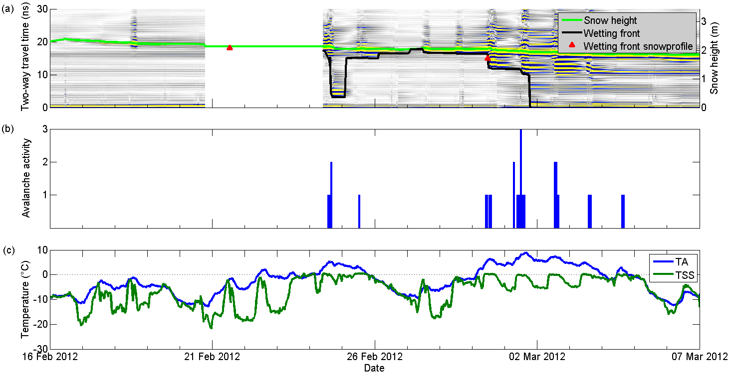
Tracking water in radar signal
Schmid et al. (2012)

Slide 31
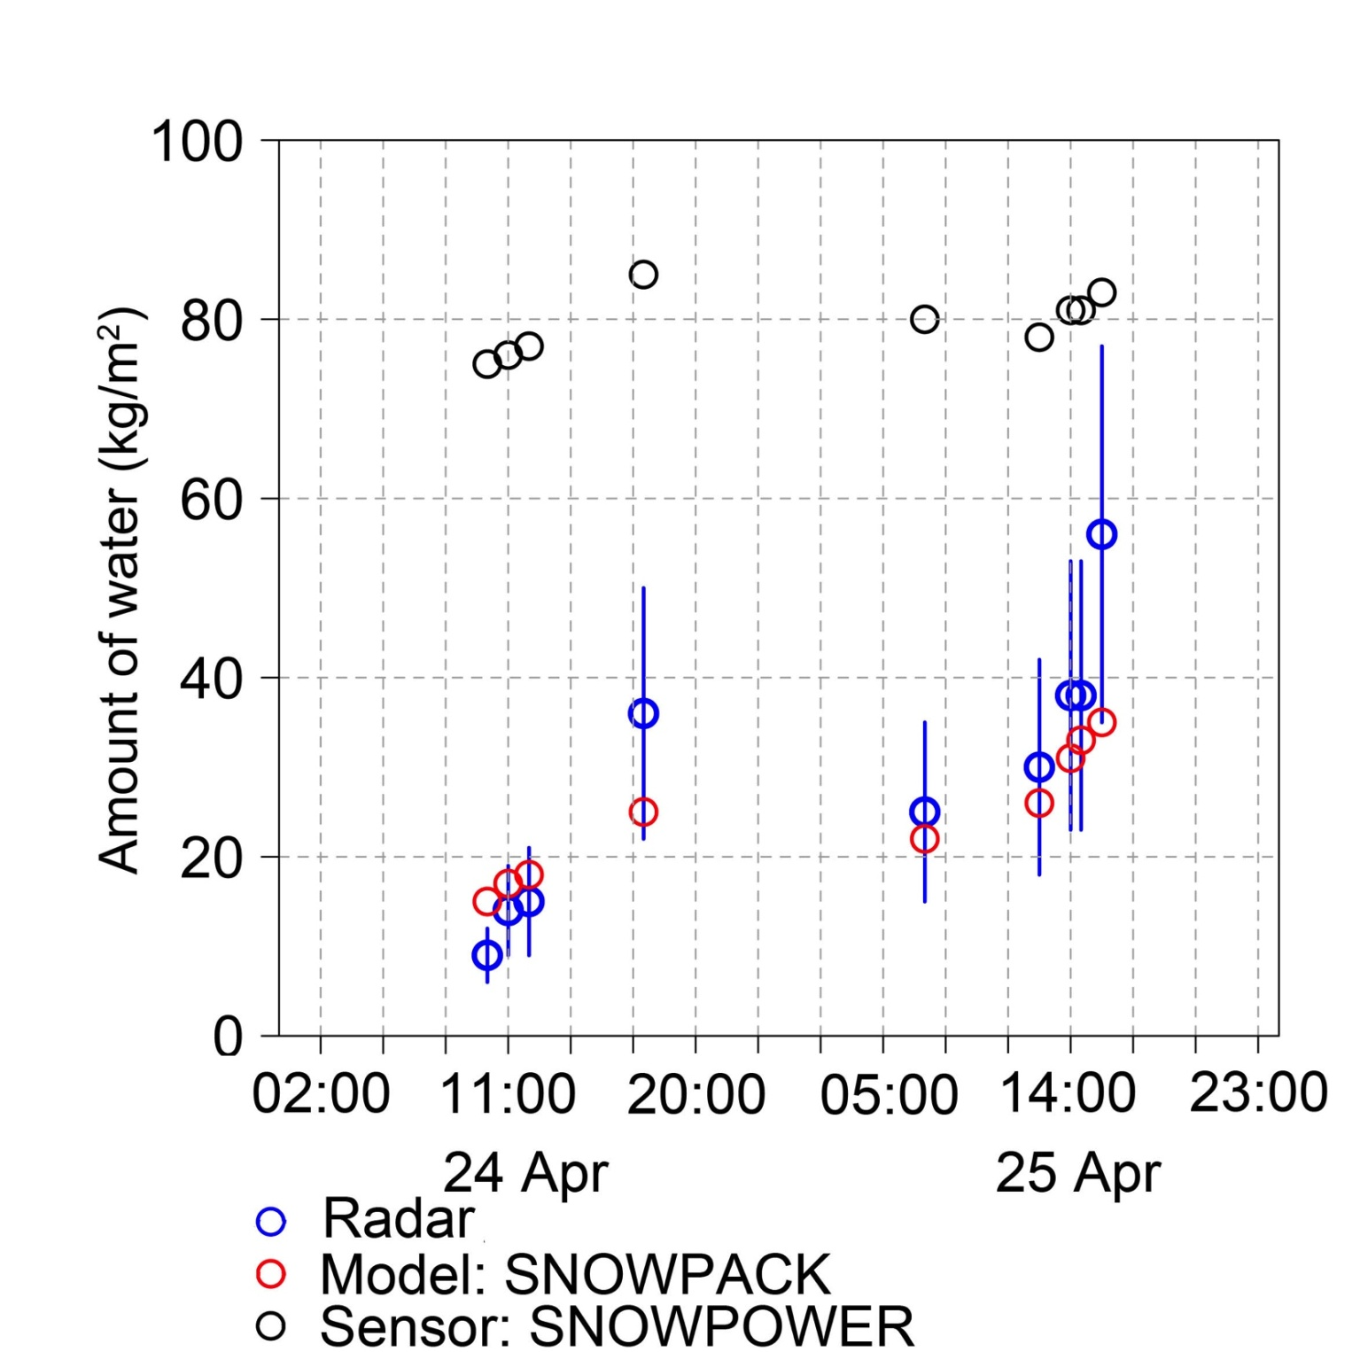
Amount of water within snowpack

Slide 32
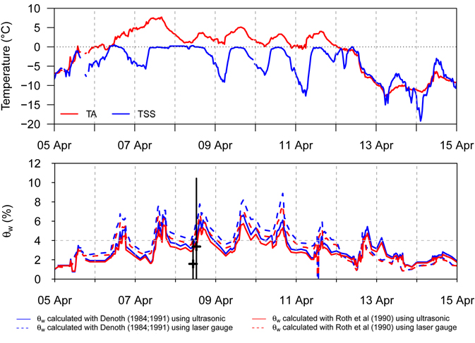
Calculating liquid water content
Schmid et al. (2014)

Slide 33
Conclusions
Moving water can be tracked.
Average liquid water content for the entire snow-pack can be calculated – but not for single layers.
Multiple reflections hint to parts of the snowpack with high liquid water content.
Flow patterns cannot be determined.
In the future, analysis of frequency content of the multiple reflections and other sensor setups may allow determining liquid water content for single layers.

Slide 34
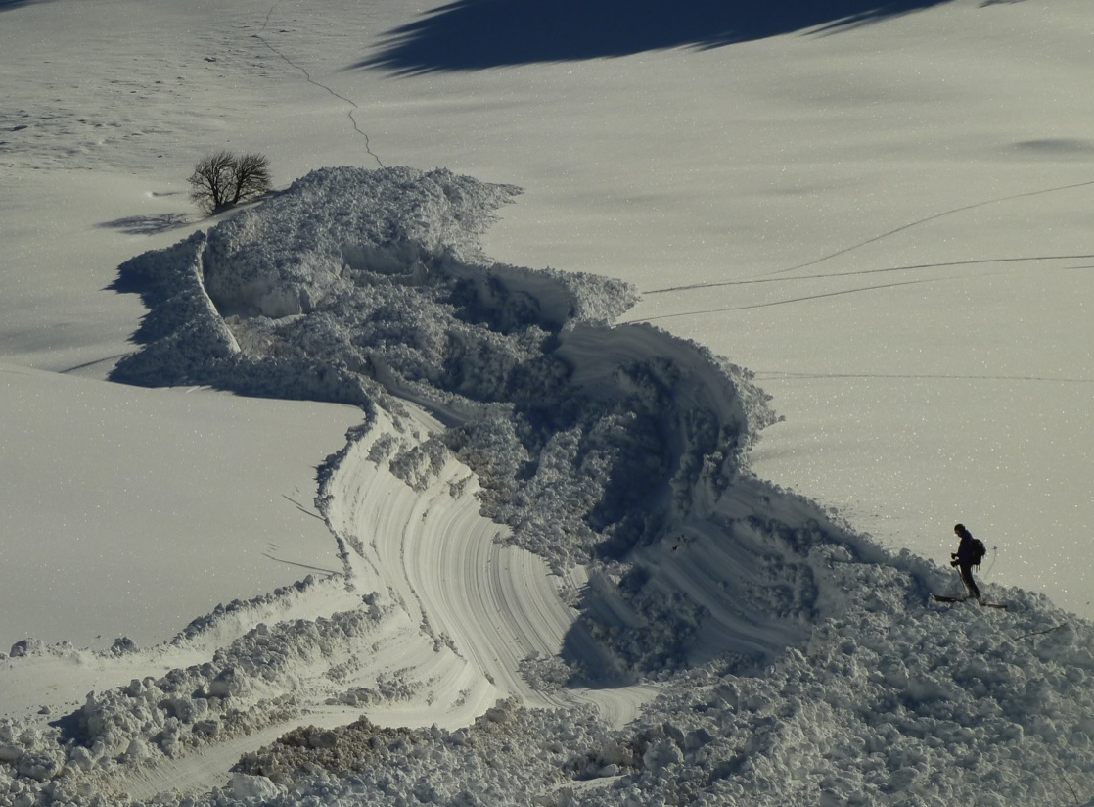
- Thank you for your attention -

